Slide 1
Filtering In Generic Collections Using List<T>
By:-
Sahil Jain

Slide 2
What is List<T>???
The List<T> represents a strongly typed collection of objects which is highly optimized for providing maximum performance and can be accessed using an index.
This class provides methods to loop, filter, sort and manipulate collections.
The non-generic version of this class is the ArrayList class.

Slide 3
Adding items in the List<T>
static void Main(string[] args)
{
List<Person> pList = new List<Person>();
pList. Add(new Person(1, "John", "", "Shields", 29, 'M'));
pList.Add(new Person(2, "Mary", "Matthew", "Jacobs", 35, 'F'));
pList.Add(new Person(3, "Amber", "Carl", "Agar", 25, 'M'));
pList.Add(new Person(4, "Kathy", "", "Berry", 21, 'F'));
pList.Add(new Person(5, "Lena", "Ashco", "Bilton", 33, 'F'));
pList.Add(new Person(6, "Susanne", "", "Buck", 45, 'F'));
pList.Add(new Person(7, "Jim", "", "Brown", 38, 'M'));
pList.Add(new Person(8, "Jane", "G", "Hooks", 32, 'F'));
pList.Add(new Person(9, "Robert", "", "", 31, 'M'));
pList.Add(new Person(10, "Cindy", "Preston", "Fox", 25, 'F'));
pList.Add(new Person(11, "Gina", "", "Austin", 27, 'F'));
pList.Add(new Person(12, "Joel", "David", "Benson", 33, 'M'));
pList.Add(new Person(13, "George", "R", "Douglas", 55, 'M'));
pList.Add(new Person(14, "Richard", "", "Banks", 22, 'M'));
pList.Add(new Person(15, "Mary", "C", "Shaw", 39, 'F'));
}

Slide 4
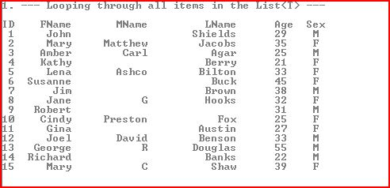
Table

Slide 5
Lambda Expression
A lambda expression is an anonymous function and it is mostly used to create delegates
Lambda basic definition: Parameters => Executed code.
Example:- n => n % 2 == 1
n is the input parameter
n % 2 == 1 is the expression
You can read this as: "input parameter named n goes to anonymous function which returns true if the input is odd".

Slide 6

Filtering List<T> using a single condition - (Age > 35)
List<Person> filterOne = pList.FindAll(p=>p.Age > 35);

Slide 7

Filtering List<T> on multiple conditions (Age > 35 and Sex is Female)
List<Person> filterOne = pList.FindAll(p=>p.Age > 35 && p.Sex==‘F’);

Slide 8
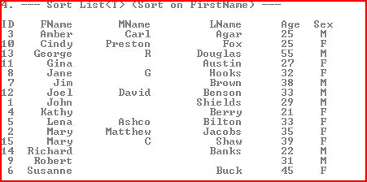
Sorting List<T> (Sort on FirstName)
List<Person> sortFName = >List.Sort((p1,p2) => p1. FirstName.CompareTo(p2.FirstName));

Slide 9
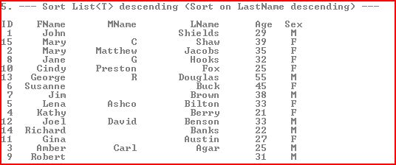
Sorting List<T> descending (Sort on LastName descending)
List<Person> sortFName = >List.Sort((p1,p2) => p2. FirstName.CompareTo(p1.FirstName));

Slide 10
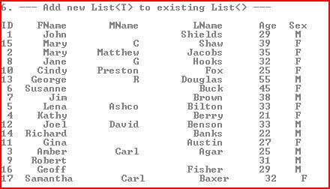
Add new List<T> to existing List<T>
List<Person> newList = new List<Person>(); newList.Add(new Person(16, "Geoff", "", "Fisher", 29, 'M'));
newList.Add(new Person(17, "Samantha", "Carl", "Baxer", 32, 'F'));
pList.AddRange(newList);

Slide 11
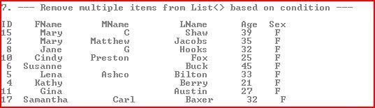
Remove multiple items from List<T> based on condition
List<Person> removeList = pList;
removeList.RemoveAll(p=>p.Sex == 'M');

Slide 12
Some other Methods & Properties
Properties
Capacity
Count
Item
Methods
Clear
Contains
Where
Exists
Example:- list.Where(r => listofIds.Contains(r.Id))
bool exists = list.Exists(element => element > 10);

